Slide 1
Shedding Light on Dark Data: The Critical Role of the Scientific Data Officer
By: Marwan Al Farah
Supervised by: Eng. Batool Al Armouti

Slide 2
Purpose Statement
This study explores the impact of classifying data on organizational efficiency, focusing on categorizing data into business-critical, dark, and ROT (Redundant, Obsolete, Trivial) types. It assesses methods for efficient data classification and the Scientific Data Officer's (SDO) role in managing data, aiming to enhance big data utilization, reduce costs, and increase operational efficiency.

Slide 3
Objectives
Assess tools for data classification, reviewing current methods and seeking enhancements for sorting data into critical, dark, and ROT categories.
Examine the SDO's influence on data management, particularly in identifying, using, and mitigating risks associated with dark data.
Explore the challenges and benefits of implementing the SDO role across various organizations, considering costs, skill needs, and effects on organizational structures.

Slide 4


Sources of Data and Data Collection Methods
Senior Data Science & AI Specialist - Officer
at a bank in Jordan
Intelligence and Analytics Unit Manager
at a software company in Jordan
Interviews
Notes:
For primary data, the research included semi-structured interviews with a Senior Data Science & AI Specialist Officer at bank in Jordan, and the Intelligence and Analytics Unit Manager at a software company in Jordan. These interviews were designed to capture a wide array of perspectives and experiences, offering insights into the practical challenges, strategies, and outcomes of managing dark data in a corporate setting.

Slide 5


Sources of Data and Data Collection Methods
Dark Data as the New Challenge for Big Data Science and the Introduction of the Scientific Data Officer
Literature Review
Veritas Databerg Report
Notes:
The project's secondary data collection involved an exhaustive literature review, spanning academic journals, industry publications, white papers, and authoritative reports on data management practices, the evolution of the SDO role, and the implications of dark data within organizational contexts. This review served to anchor the study in the current academic and professional discourse, identifying gaps in the existing research and highlighting emerging trends in data governance and strategy. Through this comprehensive approach, the project aimed to not only map the current landscape of dark data management but also to contribute meaningfully to the discourse, proposing actionable solutions and frameworks for organizations navigating the complexities of modern data ecosystems.

Slide 6
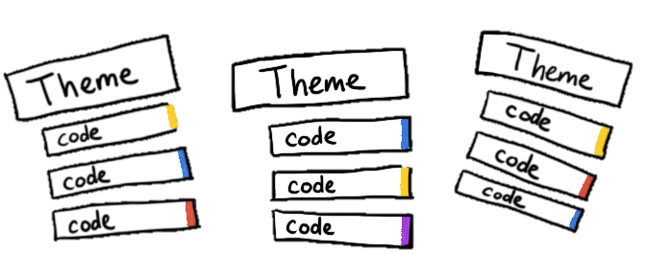
Data Analysis Tools Used
Thematic Analysis
Notes:
The project employed thematic analysis as one of its primary data analysis tools, a qualitative research method aimed at identifying, analyzing, and reporting patterns (themes) within the data. This approach was particularly suited for interpreting the rich, detailed narratives obtained from interviews with data management professionals. Thematic analysis allowed us to delve deeply into the data, extracting significant themes related to dark data challenges, the roles and responsibilities of Scientific Data Officers, and strategies for effective data management. This method facilitated a nuanced understanding of the underlying issues and opportunities presented by dark data, contributing to the development of informed recommendations and action plans.

Slide 7



Main Findings and Results
New Classification System
Scientific Data Officer
APARAVI
Notes:
The main findings and results from the collected data highlight the pivotal role of the Scientific Data Officer (SDO) in addressing the challenges of dark data management and utilization. The adoption of APARAVI, a sophisticated data classification system, emerges as a significant tool for improving data oversight and efficiency. SDOs might face numerous challenges, including navigating vast amounts of unstructured data, ensuring data privacy and security, and fostering a culture that values data-driven decision-making. The introduction of a new classification system offers a promising avenue for better managing and leveraging dark data, underscoring the vast scope of the issue across organizations. This comprehensive approach aims to unlock the potential of unused data, driving innovation and strategic insights.

Slide 8
Recommendations
Institutionalize SDO Role
Adopt Data Classification Frameworks
Leverage Technology
Foster Data-Driven Culture
Continuous Learning
Notes:
Institutionalize SDO Role: Organizations should institutionalize the SDO role to manage data across departments, driving insights and efficiencies. The growing complexity of Big Data makes the SDO's role crucial for aligning data management with organizational goals.
Adopt Data Classification Frameworks: Advanced data classification frameworks are essential for optimizing data management. Tools like APARAVI can enhance data categorization, supporting better utilization and compliance.
Leverage Technology: Investing in technology aids SDOs in managing Big Data, reducing dark data through tools for data analysis and lifecycle management.
Foster Data-Driven Culture: Promoting a culture that values data as a strategic asset can enhance data management and support SDO efforts by involving all employees in data practices.
Continuous Learning: SDOs and their teams should engage in continuous learning to keep up with data science and governance advancements, ensuring effective data management strategies.

Slide 9
Action Plan for Improvements
Engage Early with Collaborators
Utilize Advanced Tools
Refine the SDO Role Framework
Seek Feedback and Iterate
Document and Share Learnings
Notes:
Engage Early with Collaborators
Begin outreach to potential academic and industry partners at the project's inception to build a robust network for sharing data and insights.
Utilize Advanced Tools
Integrate advanced data analysis tools such as Excel and NVivo from the start to enhance data analysis capabilities.
Refine the SDO Role Framework
Work on refining the role and responsibilities of the Scientific Data Officer to ensure it aligns with organizational needs and structures.
Seek Feedback and Iterate
Regularly seek feedback on the research framework and findings from both academic peers and industry practitioners to refine the approach continuously.
Document and Share Learnings
Keep a detailed record of the research process, challenges, solutions, and outcomes to share with the broader research community.

Slide 10

Thank you

